Slide 1
Using Logistical regression to predict Yelp user review ratings

Slide 2
YELP
Founded in San Francisco in 2004
As of December 31, 2018 over 170 million reviews have been submitted for all different types of businesses
Yelp released datasets of its website data for academic purposes
Data provided in JSON format for metropolitan areas in the following locations:
Arizona
Illinois
Nevada
North Carolina
Ohio
Pennsylvania Wisconsin Alberta (Canada) Ontario (Canada) Quebec (Canada)

Slide 3
Starting Point
Six subsets to original Yelp dataset that was released
Business Information
Checkins
Photos
Reviews
Tips
Users
Imported into R using stream_in() function in jsonlite library
Combined Business Information and Reviews for training dataset

Slide 4
Initial review of the data
Assumption for the project:
Reviews with less than 3 stars considered “negative”
Reviews with 3 or more stars considered “positive”
False (Not a negative review) | True (Negative review)
230,218 | 69,782
230218/(230218+69782) = 0.7673933 $≈$ 76.7%

Slide 5
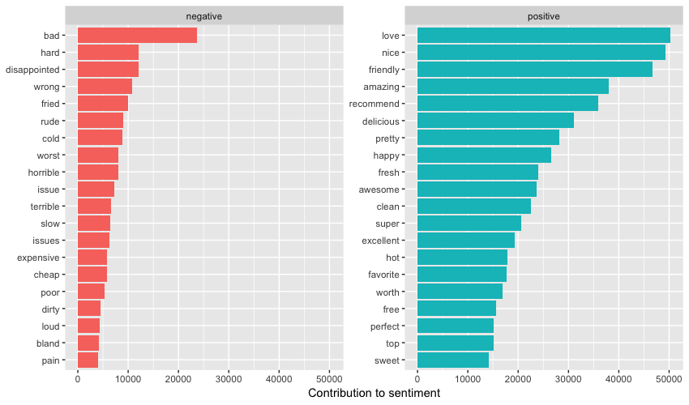

Slide 6
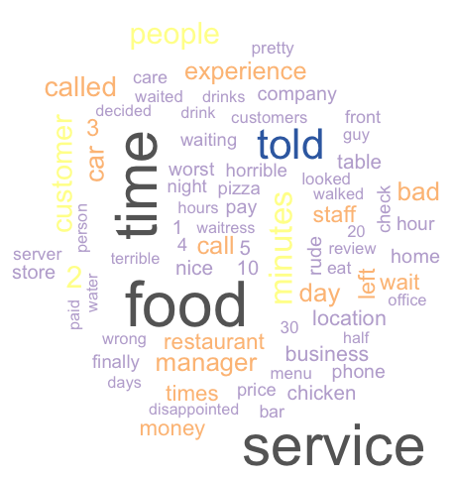
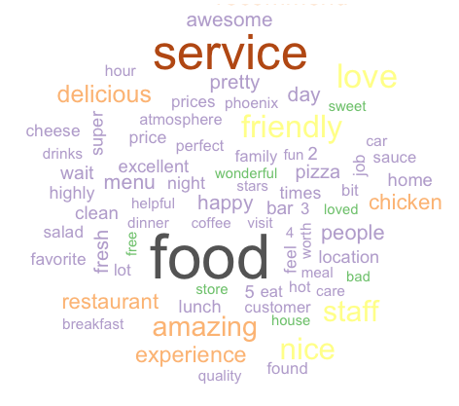
WordCLOUDs
Generated using negative reviews
Generated using positive reviews

Slide 7
Data Wrangling
Words contained in user reviews separated and put into a corpus
All characters converted to lowercase
Punctuation removed
Stopwords from the tm library removed from reviews
Words stemmed
Terms occurring in 2% or more of reviews were used for a total of 453 words using the Bag of Words model
Reviews were split 70/30 – 210,000 reviews for training and 90,000 reviews for testing

Slide 8
Creation of a model
rpart library
Used the calculated Negative column to compare columns of recurring words
Words imported as factors requiring method = “class”
Model = rpart(Negative ~ ., data = trainingData, method = "class")

Slide 9
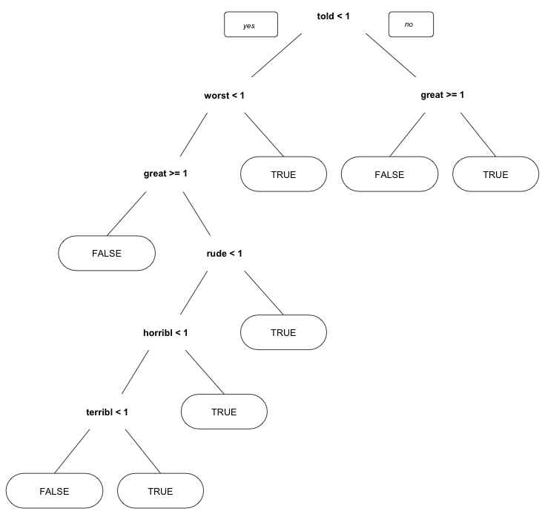
Decision Tree

Slide 10
Results
 | False | True
False | 66,812 | 2,253
True | 13,212 | 7,723
(66862+7723)/(66862+2203+13215+7723) = 0.8281667 $≈$ 82.8%

Slide 11
LEVERAGING THE MODEL
Solution:
Help businesses identify common terms used in negative reviews to know where to focus their efforts to improve customer satisfaction.
Implementation:
Build the logistic regression model results into its website
Provide data to businesses to help improve customer satisfaction
Provide information free of charge to businesses or at a fee
Depending on the Yelp’s business model
At the discretion of executive management

Slide 12
LEVERAGING THE MODEL
Solution:
Identify reviews in which the person erroneously selected a negative rating (less than 3 stars) even though their experience was generally positive.
Implementation:
Yelp provides information to people about businesses in a given area
Star ratings that are inconsistent with the language used in the review, it can lead to a loss in credibility
Verification of language consistent with a positive or negative review either at the time of submission of the review or after the fact
Provide an additional level of quality control

